Slide 1

ResAI Toolkit: Framework for Cross-Modality Bias Detection
24-25J-195

Slide 2
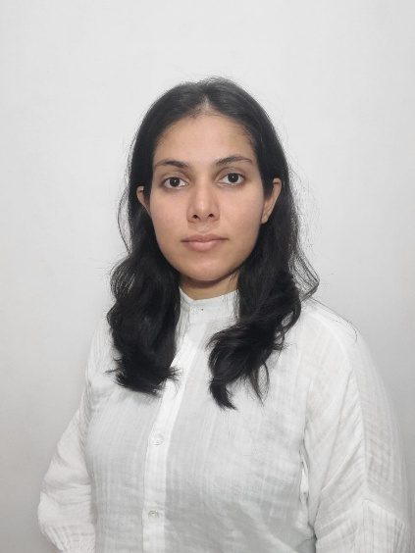
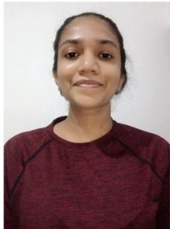

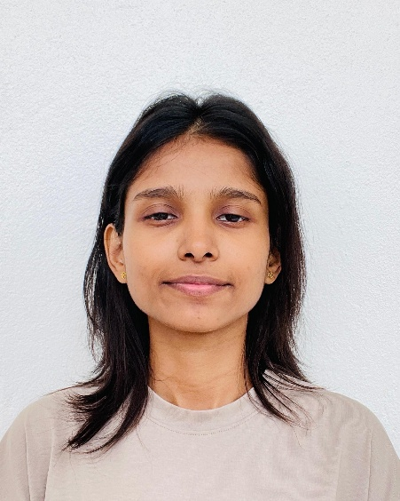
Team
K.M.S.P. Jayawardena.
E.M.A.M Ekanayake.
H.M.I.K Dhanawardena.
T. N. Mudalige.

Slide 3
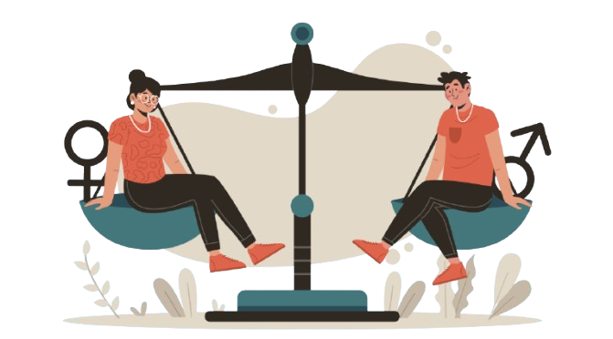
The Focus of Our research?
Our research focuses on developing metrics for detecting GENDER BIAS in text, image, audio, and video datasets.

Slide 4
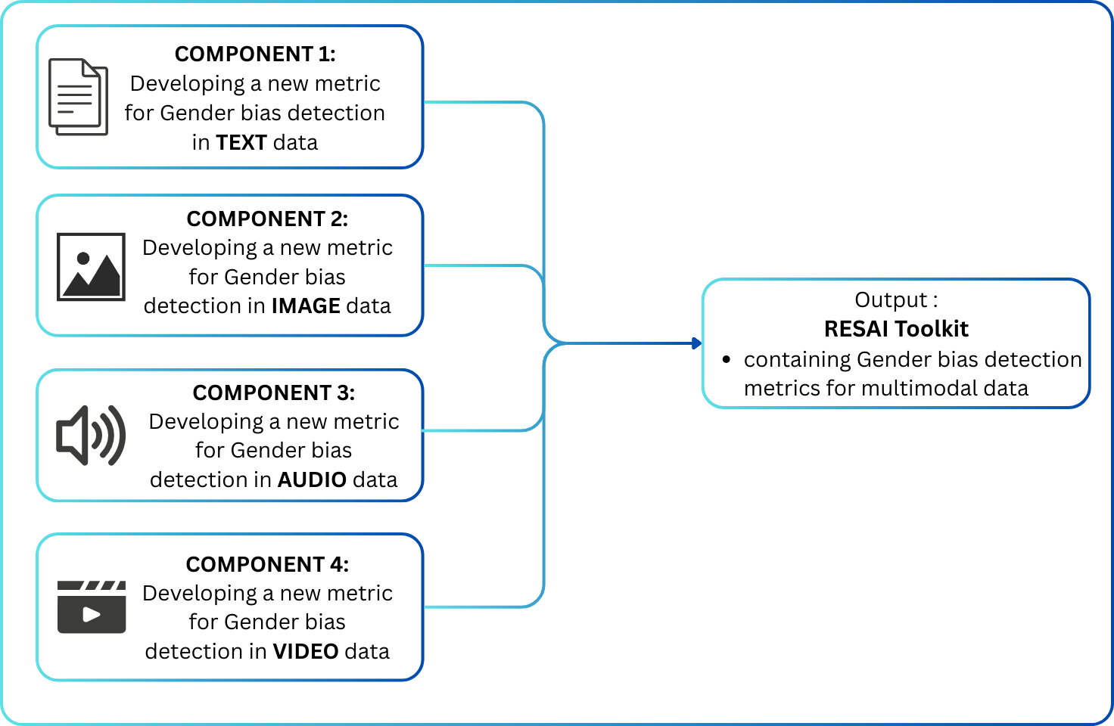
How does the ResAI Toolkit revolutionize AI bias detection?

Slide 5

IT21380914 | K. M. S. P. JAYAWARDENA
Data Science
IT21380914 | K. M. S. P. Jayawardena | 24_25J_195

Slide 6

NEW METRIC FOR GENDER BIAS DETECTION IN AUDIO DATASETs.
IT21380914 | K. M. S. P. Jayawardena | 24_25J_195

Slide 7
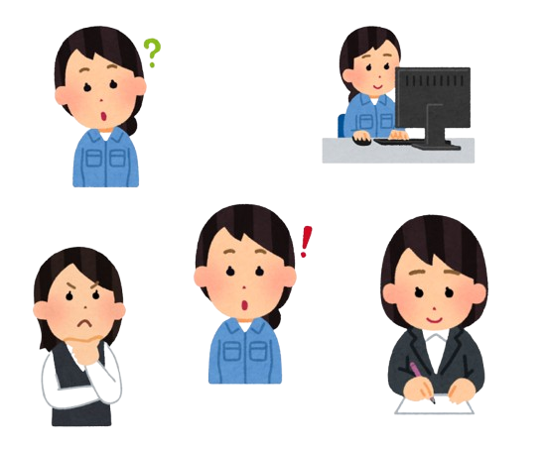
Why is detecting bias in Audio data important?.
Audio Data is used to build systems in critical areas:
Healthcare
Law enforcement
Where Unfair systems will predict unfair outcomes which will cause significant harm.
IT21380914 | K. M. S. P. Jayawardena | 24_25J_195

Slide 8
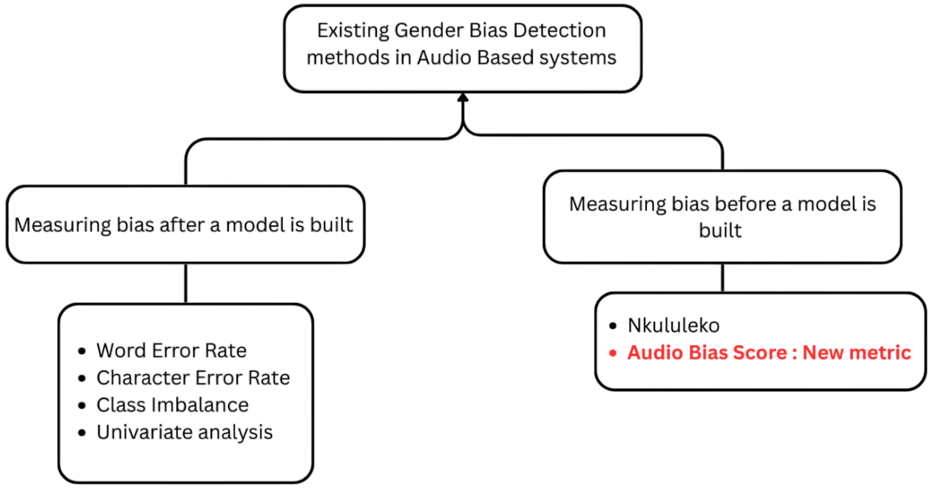
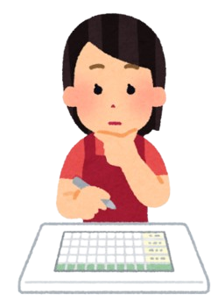
How has Bias in Audio systems being measured ?
IT21380914 | K. M. S. P. Jayawardena | 24_25J_195

Slide 9
How is the new metric different?
New Metric measure bias using raw audio features, Addressing the limitations of:
Lack of metrics that measure dataset bias alone.
Out of distribution error
IT21380914 | K. M. S. P. Jayawardena | 24_25J_195

Slide 10
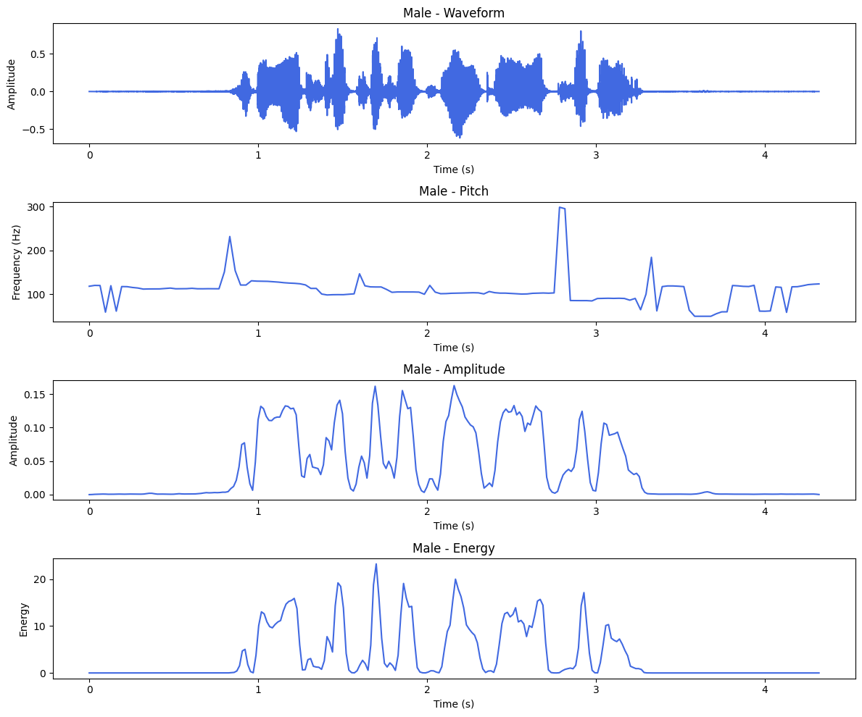
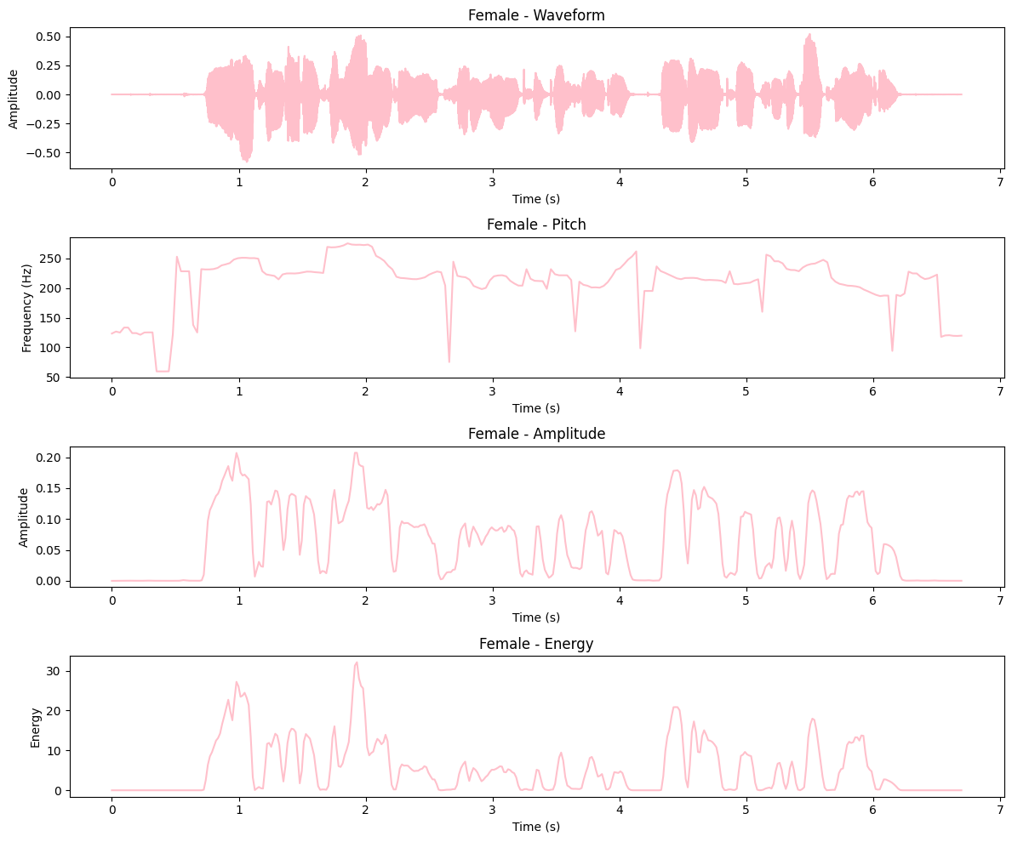
Selection of features.
Final features considered:
Count of audios per gender.
Voice activity per gender.
Standard deviation of Pitch.
Standard deviation of Energy
Standard deviation of Amplitude
IT21380914 | K. M. S. P. Jayawardena | 24_25J_195

Slide 11
Data Extraction and preprocessing.
Sources of Data:
Common voice dataset.
Librispeech General dataset.
Multilingual Librispeech dataset.
Tedlium Dataset.
The AMI corpus.
The extracted Data was the augmented to reflect a manually introduced bias to build the metric.
IT21380914 | K. M. S. P. Jayawardena | 24_25J_195

Slide 12
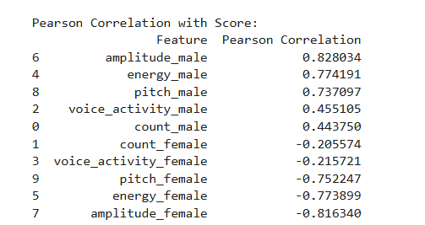
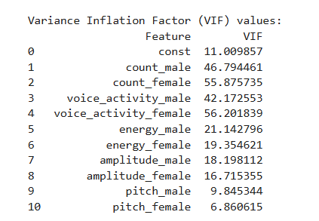
Checking the assumptions for regression.
Multi-collinearity was detected within the features.
Non-Linearity was detected within the dataset
IT21380914 | K. M. S. P. Jayawardena | 24_25J_195

Slide 13
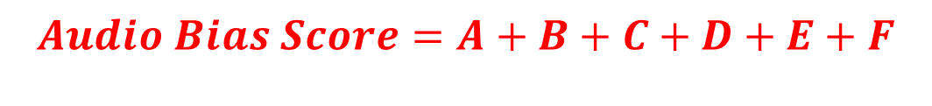
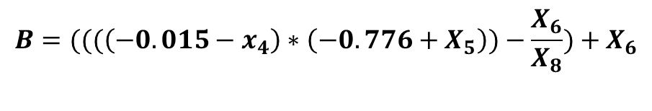
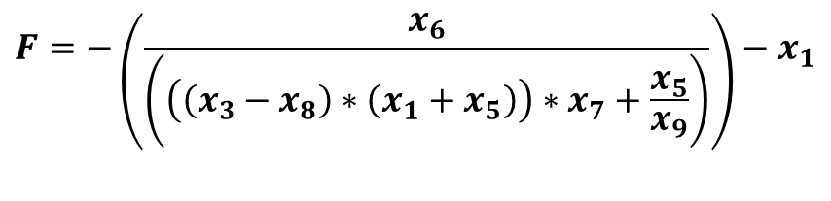
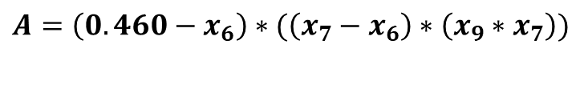
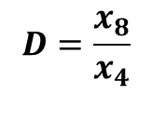
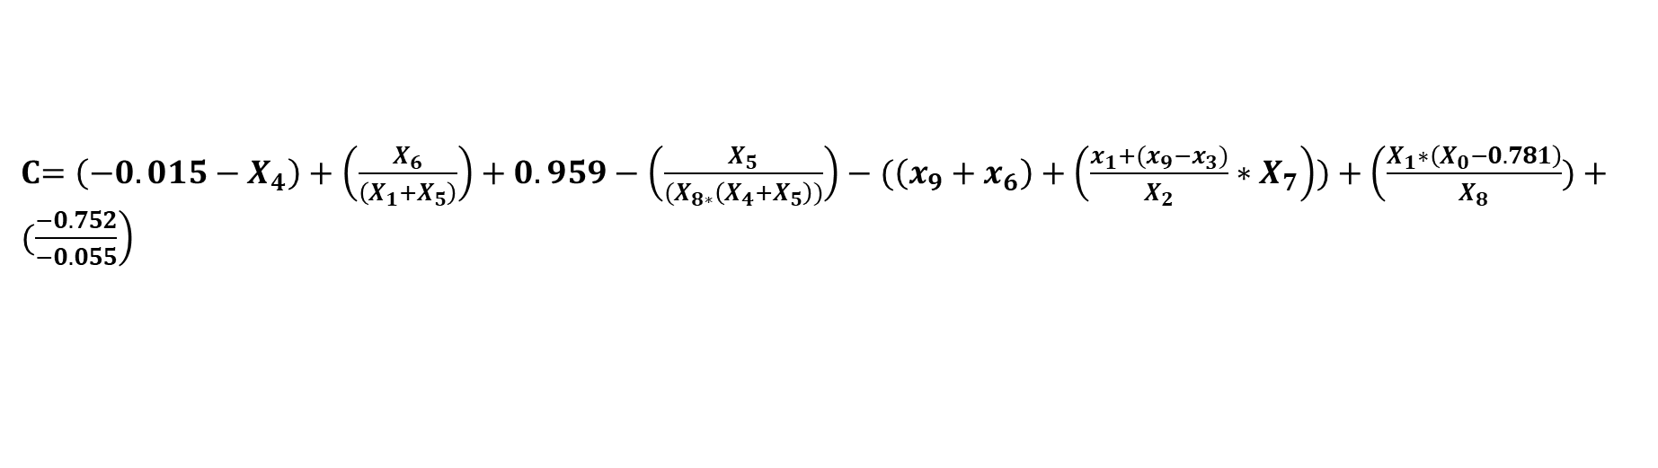
Generating the equation Method 1 : Symbolic Regression
$$A=\left(0.460−x_{6}\right)∗(\left(x_{7}−x_{6}\right)∗\left(x_{9}∗x_{7}\right))$$
$$B=(((\left(−0.015−x_{4}\right)∗\left(−0.776+X_{5}\right))−\frac{X_{6}}{X_{8}})+X_{6}$$
C$=\left(−0.015−X_{4}\right)+\left(\frac{X_{6}}{\left(X_{1}+X_{5}\right)}\right)+0.959−\left(\frac{X_{5}}{{(X}_{8∗}\left(X_{4}+X_{5}\right))}\right)−(\left(x_{9}+x_{6}\right)+\left(\frac{x_{1}+(x_{9}−x_{3})}{X_{2}}∗X_{7}\right))+\left(\frac{X_{1}∗\left(X_{0}−0.781\right)}{X_{8}})+(\frac{−0.752}{−0.055}\right)$
$$D=\frac{x_{8}}{x_{4}}$$
$$E=x_{9}+((\left(−0.015−x_{4}\right)∗\left(−0.776+x_{5}\right)∗x_{9})+\left(\left(x_{7}−x_{6}\right)∗\left(x_{9}∗x_{7}\right)\right))$$
$$F=−\left(\frac{x_{6}}{\left(\left(\left(x_{3}−x_{8}\right)∗\left(x_{1}+x_{5}\right)\right)∗x_{7}+\frac{x_{5}}{x_{9}}\right)}\right)−x_{1}$$
X0 = number of male audios
X1 = number of female audios
X2= Voice activity time of male
X3 = voice activity of time of female
X4 = Standard deviation of Energy levels male
X5= Standard deviation of Energy levels female.
X6 = Standard deviation of amplitudes male
X7 = Standard deviation of amplitudes female
X8 = Standard deviation of pitch male
X9 = Standard deviation of pitch female
$$Audio Bias Score=A+B+C+D+E+F$$
IT21380914 | K. M. S. P. Jayawardena | 24_25J_195

Slide 14
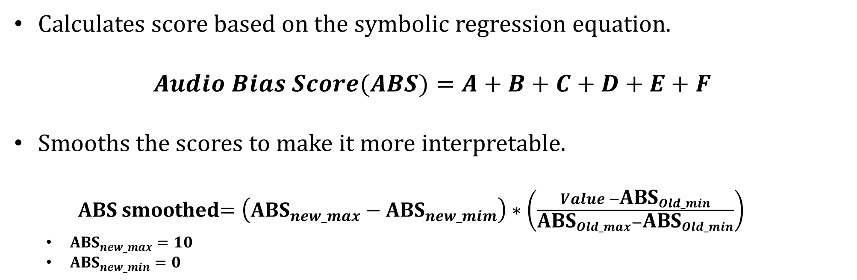
Generating the equation Method 1 : Symbolic Regression
Calculates score based on the symbolic regression equation.
$$Audio Bias Score(ABS)=A+B+C+D+E+F$$
Smooths the scores to make it more interpretable.
ABS smoothed$=\left({\text{ABS}}_{new_max}−{\text{ABS}}_{new_mim}\right)∗\left(\frac{Value −{\text{ABS}}_{Old_min}}{{\text{ABS}}_{Old_max}−{\text{ABS}}_{Old_min}}\right)$
${\text{ABS}}_{new_max}=10$
${\text{ABS}}_{new_min}=0$
IT21380914 | K. M. S. P. Jayawardena | 24_25J_195

Slide 15
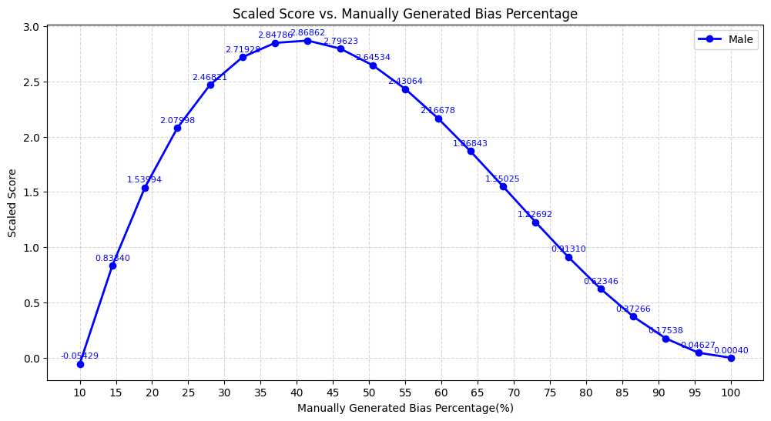
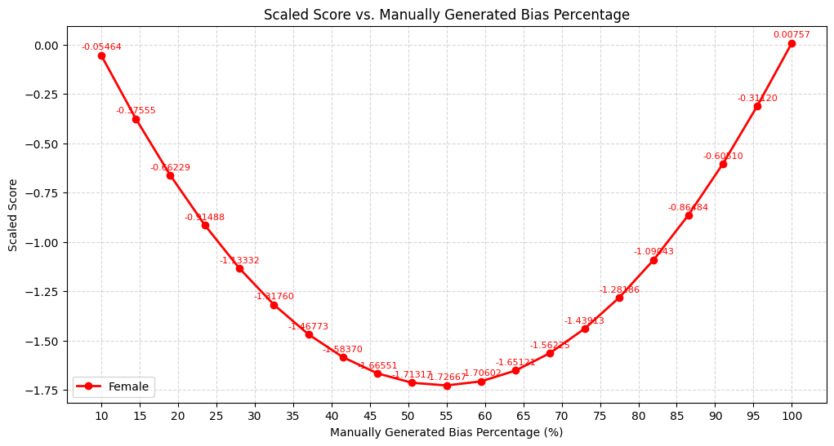
Generating the equation Method 1 : Symbolic Regression
Testing with Manually controlled datasets.
IT21380914 | K. M. S. P. Jayawardena | 24_25J_195

Slide 16
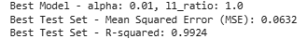
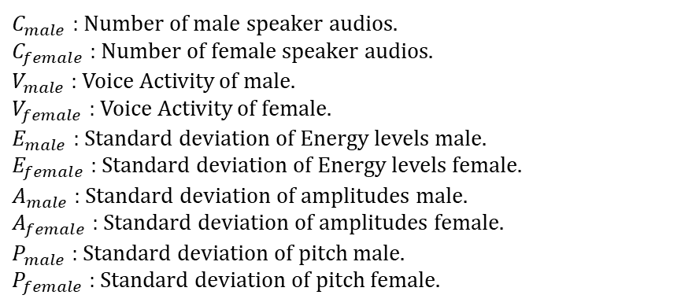
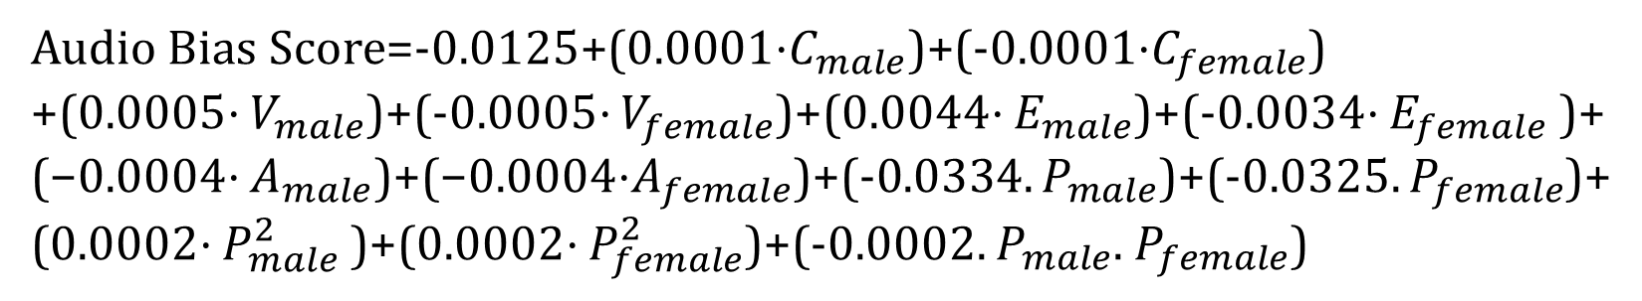
Generating the equation Method 2 : Polynomial Ridge Regression.
Audio Bias Score=-0.0125+(0.0001⋅$C_{male}$​)+(-0.0001⋅$C_{female}$​)
+(0.0005⋅ $V_{male}$​)+(-0.0005⋅ $V_{female}$​)+(0.0044⋅ $E_{male}$​​)+(-0.0034⋅ $E_{female}$​ ​)+
(−0.0004⋅ $A_{male}$​)+(−0.0004⋅$A_{female}$​)+(-0.0334. $P_{male}$)+(-0.0325. $P_{female}$)+
(0.0002⋅ $P_{male}^{2}$​)+(0.0002⋅ $P_{female}^{2}$)+(-0.0002. $P_{male}$. $P_{female}$)
$C_{male}$ : Number of male speaker audios.
$C_{female}$: Number of female speaker audios.
$V_{male}$ : Voice Activity of male.
$V_{female}$ : Voice Activity of female.
$E_{male}$ : Standard deviation of Energy levels male.
$E_{female}$ : Standard deviation of Energy levels female.
$A_{male}$ : Standard deviation of amplitudes male.
$A_{female}$ : Standard deviation of amplitudes female.
$P_{male}$ : Standard deviation of pitch male.
$P_{female}$ : Standard deviation of pitch female.
IT21380914 | K. M. S. P. Jayawardena | 24_25J_195

Slide 17
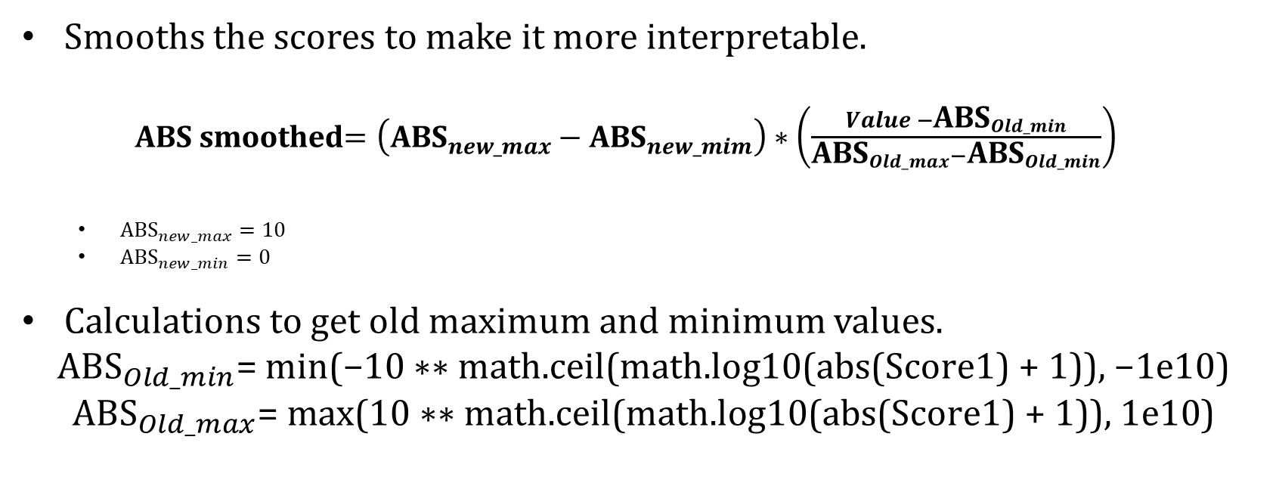
Generating the equation Method 2 : Polynomial Ridge Regression.
Smooths the scores to make it more interpretable.
ABS smoothed$=\left({\text{ABS}}_{new_max}−{\text{ABS}}_{new_mim}\right)∗\left(\frac{Value −{\text{ABS}}_{Old_min}}{{\text{ABS}}_{Old_max}−{\text{ABS}}_{Old_min}}\right)$
${\text{ABS}}_{new_max}=10$
${\text{ABS}}_{new_min}=0$
Calculations to get old maximum and minimum values.
$${\text{ABS}}_{Old_min}\text{= }\text{min}\text{(−10 ∗∗ }\text{math}\text{.}\text{ceil}\text{(}\text{math}\text{.}\text{log}\text{10(}\text{abs}\text{(}\text{Score}\text{1) + 1)), −1}\text{e}\text{10)}$$
$${\text{ABS}}_{Old_max}\text{= }\text{max}\text{(10 ∗∗ }\text{math}\text{.}\text{ceil}\text{(}\text{math}\text{.}\text{log}\text{10(}\text{abs}\text{(}\text{Score}\text{1) + 1)), 1}\text{e}\text{10)}$$
IT21380914 | K. M. S. P. Jayawardena | 24_25J_195

Slide 18
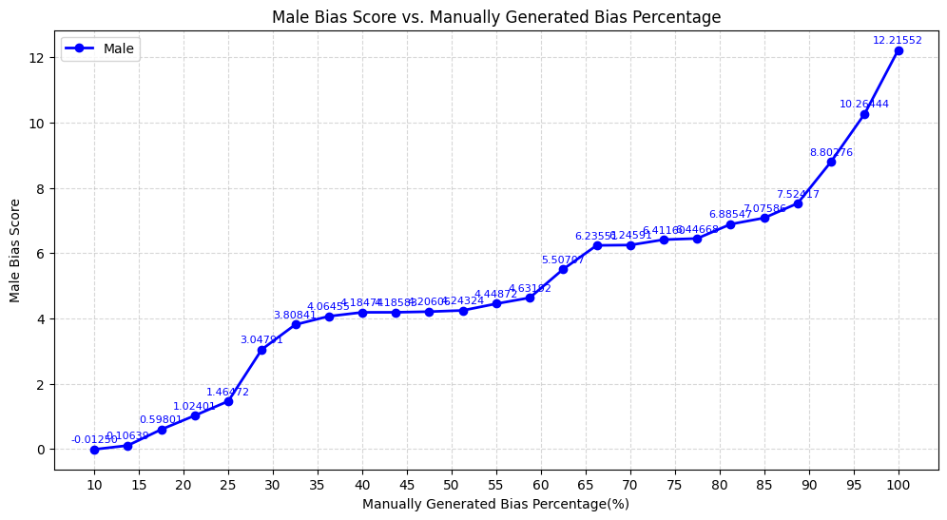
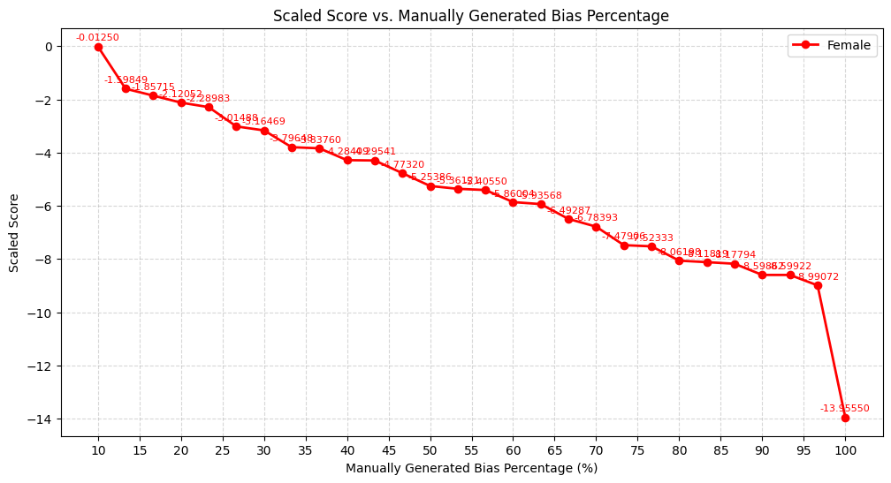
GENERATING THE EQUATION METHOD 2 : POLYNOMIAL RIDGE REGRESSION.
Testing with controlled datasets.
IT21380914 | K. M. S. P. Jayawardena | 24_25J_195

Slide 19
VALIDATING THE METRIC
Why Use Word Error Rate (WER)?
WER is a widely accepted evaluation metric in:
Speech recognition
Bias detection in audio AI systems
How WER Indicates Bias
Lower WER → Model favors that gender
Example: Higher WER for females → Male-biased model
How Audio Bias Score Indicates Bias
Positive score → Male-biased dataset
Negative score → Female-biased dataset
IT21380914 | K. M. S. P. Jayawardena | 24_25J_195

Slide 20
VALIDATING THE METRIC
Datasets | WER male | WER female | Bias defined by WER | Bias score | Definition of the score
LibriSpeech: Dev split | 20.05 | 26.3 | System : Male biased | 0.650504 | Dataset : Male Biased
LibriSpeech: Test-other split | 16.0625 | 19.0588 | System : Male biased | 1.263191 | Dataset : Male Biased
LibriSpeech: Test-clean split | 22.45 | 24.75 | System : Male biased | 0.811159 | Dataset : Male Biased
LibriSpeech Train split | 31.5104 | 32.0797 | System : Male biased | 0.713163 | Dataset : Male Biased
Multi-lingual LibriSpeech : Portuguese | 1.148 | 1.2917 | System : Male biased | -4.79006 | Dataset : Female Biased
Multi-lingual LibriSpeech : Polish | 1.222 | 1.2009 | System : Female biased | 6.279849 | Dataset : Male Biased
Common voice : Hakha Chin Train split | 1.17 | 1.2114 | System : Male biased | 1.259123 | Dataset : Male Biased
Common voice : Hakha Chin other-split | 1.1913 | 1.1497 | System : Female biased | -5.24067 | Dataset : Female Biased
Common voice : Hakha Chin validated split | 1.1816 | 1.1599 | System : Female biased | -0.23507 | Dataset : Female Biased
Common voice : Chuvash test split | 1.2571 | 1.2261 | System : Female biased | -3.51048 | Dataset : Female Biased
IT21380914 | K. M. S. P. Jayawardena | 24_25J_195

Slide 21
LIMITATIONS OF THE METRIC.
It only considers the demography gender.
In the demography gender it only consider two classes male and female
These will be addressed in future researches
IT21380914 | K. M. S. P. Jayawardena | 24_25J_195

Slide 22
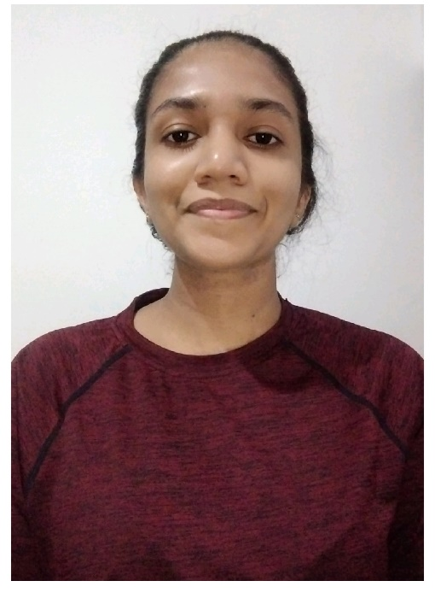
IT21387562 | E.M.A.M.Ekanayake
Data Science
IT21387562 | E.M.A.M.Ekanayake | 24_25J_195

Slide 23
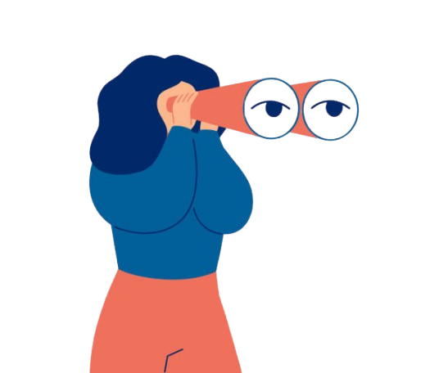
Developing Metrics for MeasurE Gender Bias in Image Datasets Using Contextual Factors: Objects, Scenes, and Spatial Relationships
This component has been accepted and will be published at the ICECET 2025 Conference (France) — an IEEE-indexed conference with an H-index of 13.
IT21387562 | E.M.A.M.Ekanayake | 24_25J_195

Slide 24

WHAT IS CONTEXUAL GENDER BIAS IN IMAGS?
The term "contextual gender bias" describes how background information (objects) or the surrounding context (background scene) can change how we perceive the gender of the person.
IT21387562 | E.M.A.M.Ekanayake | 24_25J_195

Slide 25
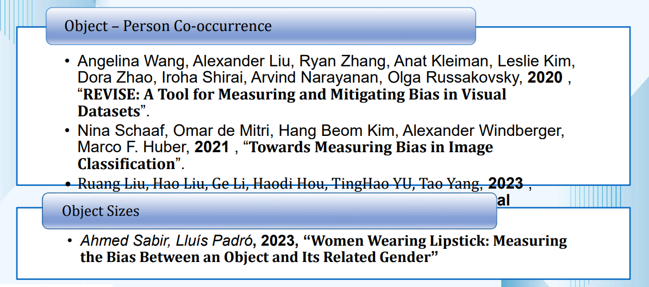
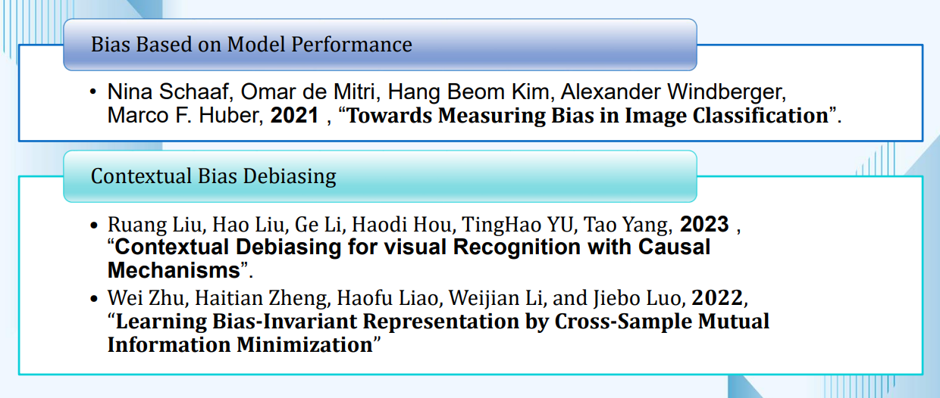
Existing Metric & Related Works
IT21387562 | E.M.A.M.Ekanayake | 24_25J_195

Slide 26
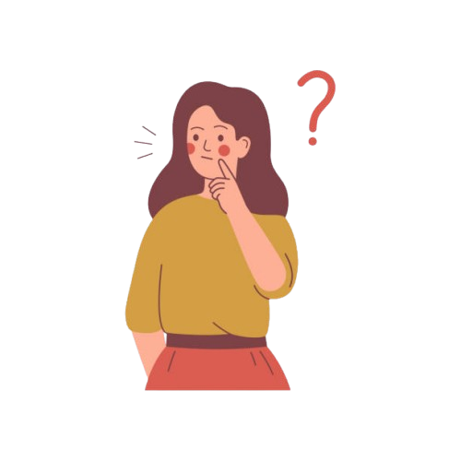
Limitations of existing metrics.
Most existing metrics focus on object co-occurrence, ignoring important factors like object size, distance, and scene context needed to understand gender bias in datasets.
IT21387562 | E.M.A.M.Ekanayake | 24_25J_195

Slide 27
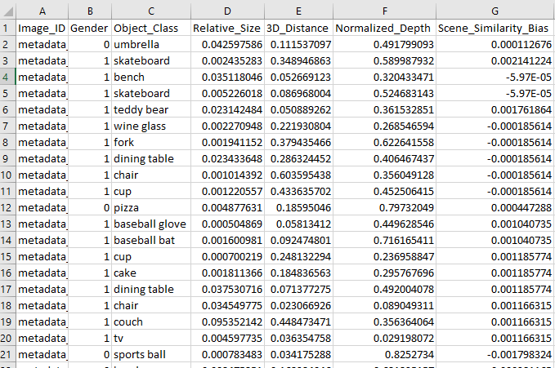
Solution – Unified Bias Metric (UBM)
UBM Combines: OIS → Object Influence Score SSB → Scene Similarity Bias
UBM Score = Weighted Combination of OIS and SSB.
IT21387562 | E.M.A.M.Ekanayake | 24_25J_195

Slide 28
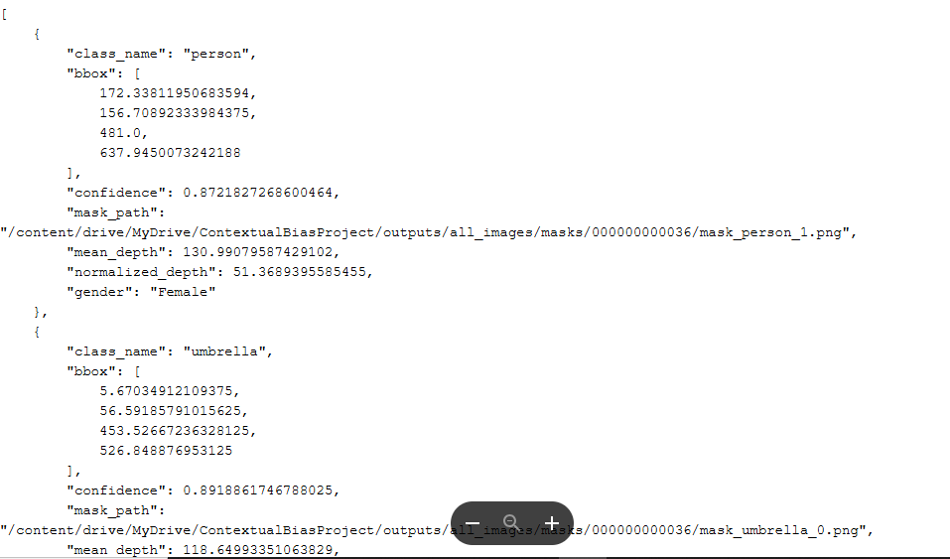
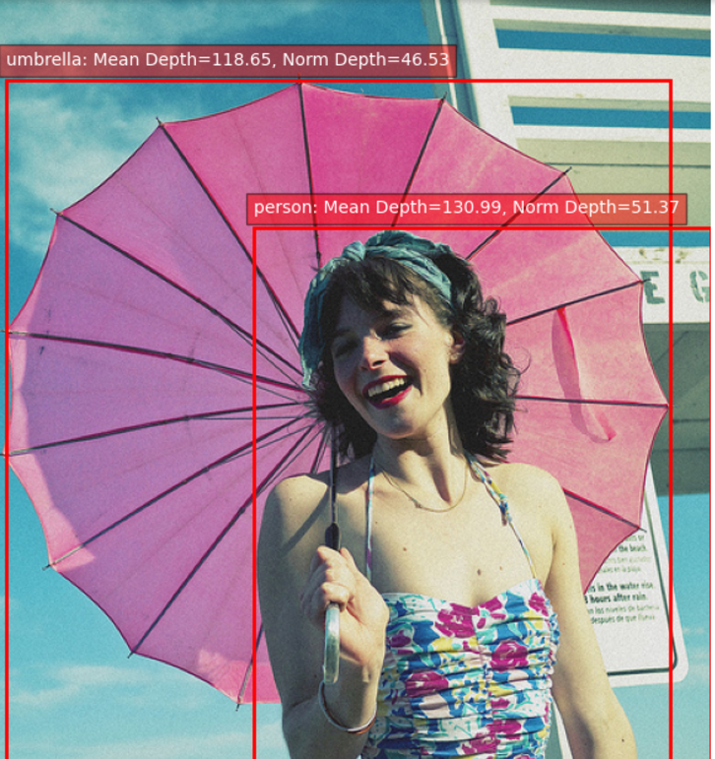
Solution – Unified Bias Metric (UBM)
Extracted Metadata Per Image in the Dataset(COCO).
Object Details: Bounding box, segmentation mask, confidence score.
Depth & Spatial Metrics: Object size, 3D distance, normalized depth.
Scene Embedding: 512-dimensional feature vector for scene classification.
Gender Annotation: Assigned to detected person instances.
IT21387562 | E.M.A.M.Ekanayake | 24_25J_195

Slide 29
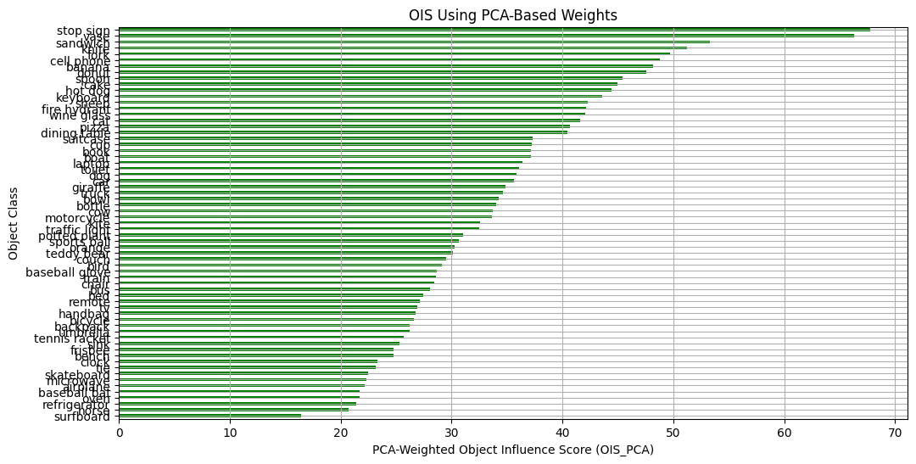
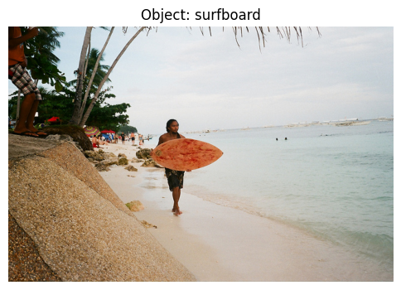
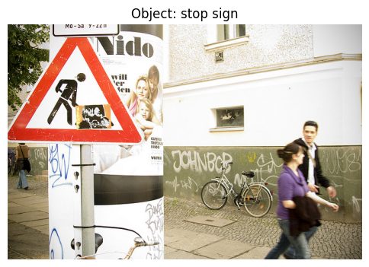
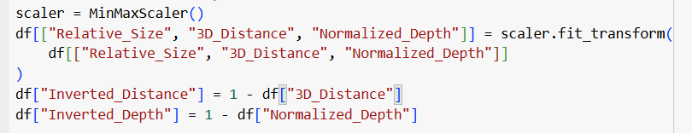
OIS – OBJECT INFLUENCE SCORE
Based on Relative Size, Inverted 3D Distance & Inverted Depth
Measures how much an object affects gender classification.
$$OIS=w1 ∗Relative Size+w2 ∗Inverted 3D Distance+w3 ∗Inverted Depth$$
IT21387562 | E.M.A.M.Ekanayake | 24_25J_195

Slide 30
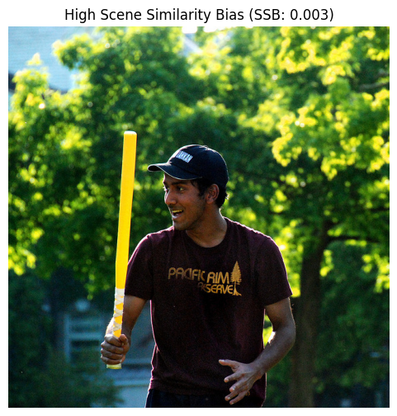
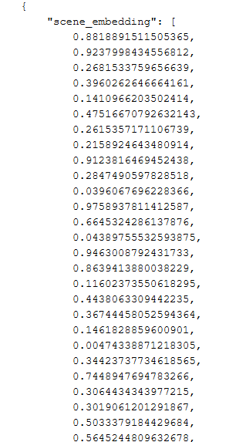
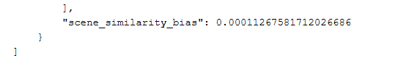
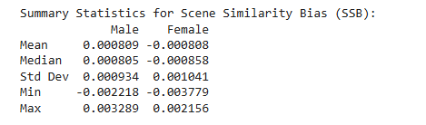
Scene Similarity Bias
Scene context is stored as high-dimensional embeddings.
To quantify scene influence on gender bias, we need a single numerical value.
For each image, we compute cosine similarity of scene embeddings with predefined male-dominated and female-dominated scene vectors.
SSB = Similarity (Male) - Similarity (Female)
IT21387562 | E.M.A.M.Ekanayake | 24_25J_195

Slide 31
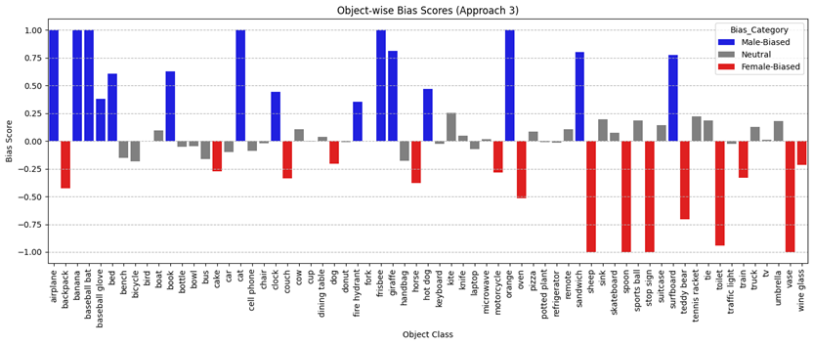
Final Formula
Final Matric
Quantifies how objects and scenes jointly influence gender bias in image datasets.
$$UBM(obj)=α(OIS male​ −OIS female​ )+β(SSB male​ −SSB female​ )$$
Positive UBM → Object is more male-associated in the dataset.
Negative UBM → Object is more female-associated in the dataset.
UBM close to zero → Object is gender-neutral.
Normalized UBM value to [+1,-1]
IT21387562 | E.M.A.M.Ekanayake | 24_25J_195

Slide 32
Approaches to Compute UBM
Different approaches can capture different aspects of bias (e.g., feature importance, SHAP values, PCA).
Approaches Tried:
Approach 1: PCA/Random Forest Feature Importance.
Approach 2: SHAP-Based Bias Scores.
Approach 3: SHAP + PCA Combined Weights.
Approach 4: XGBoost + SHAP.
Approach 5: XGBoost + SHAP + SMOTE.
Approach 6: XGBoost + SHAP + PCA.
Approach 7: XGBoost + SHAP + Optuna
Approach 8: PCA + SHAP + Correlation based weights
Approach 9: PCA + SHAP + Ridge Regression
IT21387562 | E.M.A.M.Ekanayake | 24_25J_195

Slide 33
Dataset Design for Evaluation
To rigorously evaluate metric’s behaviour under different bias conditions, six datasets were prepared:
Dataset | Description
Original Dataset | Full set of 852 annotated samples containing person-object-scene triplets.
Balanced Bias Dataset | Equal male and female distribution across all object classes. Used for baseline fairness evaluation.
Neutral Dataset | Composed of objects equally occurring across genders with no prior known bias.
Male Biased (All Genders) | Maintains all object classes but increases male-label frequency, allowing mixed but skewed bias testing.
Female Biased (All Genders) | Same as above but skewed toward female label distribution.
Top Extreme Bias Dataset | Contains only the most gender-polarized object types (e.g., handbag, baseball bat), stress-testing bias metrics.
IT21387562 | E.M.A.M.Ekanayake | 24_25J_195

Slide 34
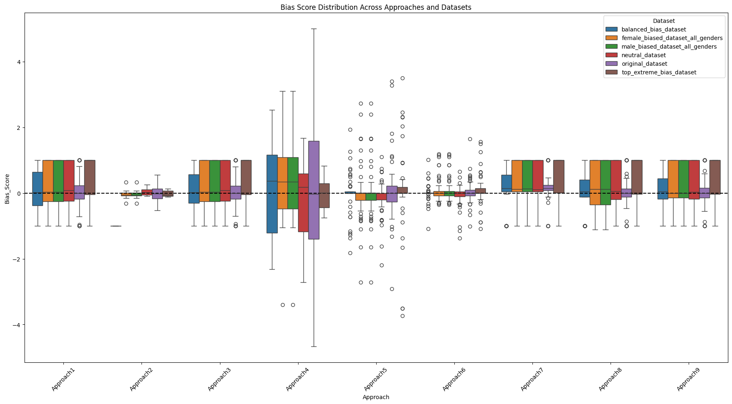
Approach Overview
Bias Score Distribution Across the Approaches – BoxPlot
Approaches 1, 3, 7, 8 and 9 show stable and consistent results with low bias variation.
Approach 4 has high variance and many outliers, meaning it's sensitive to noise.
Approaches 5 and 6 have moderate variation, showing that SMOTE and Ridge help balance flexibility and control.
IT21387562 | E.M.A.M.Ekanayake | 24_25J_195

Slide 35
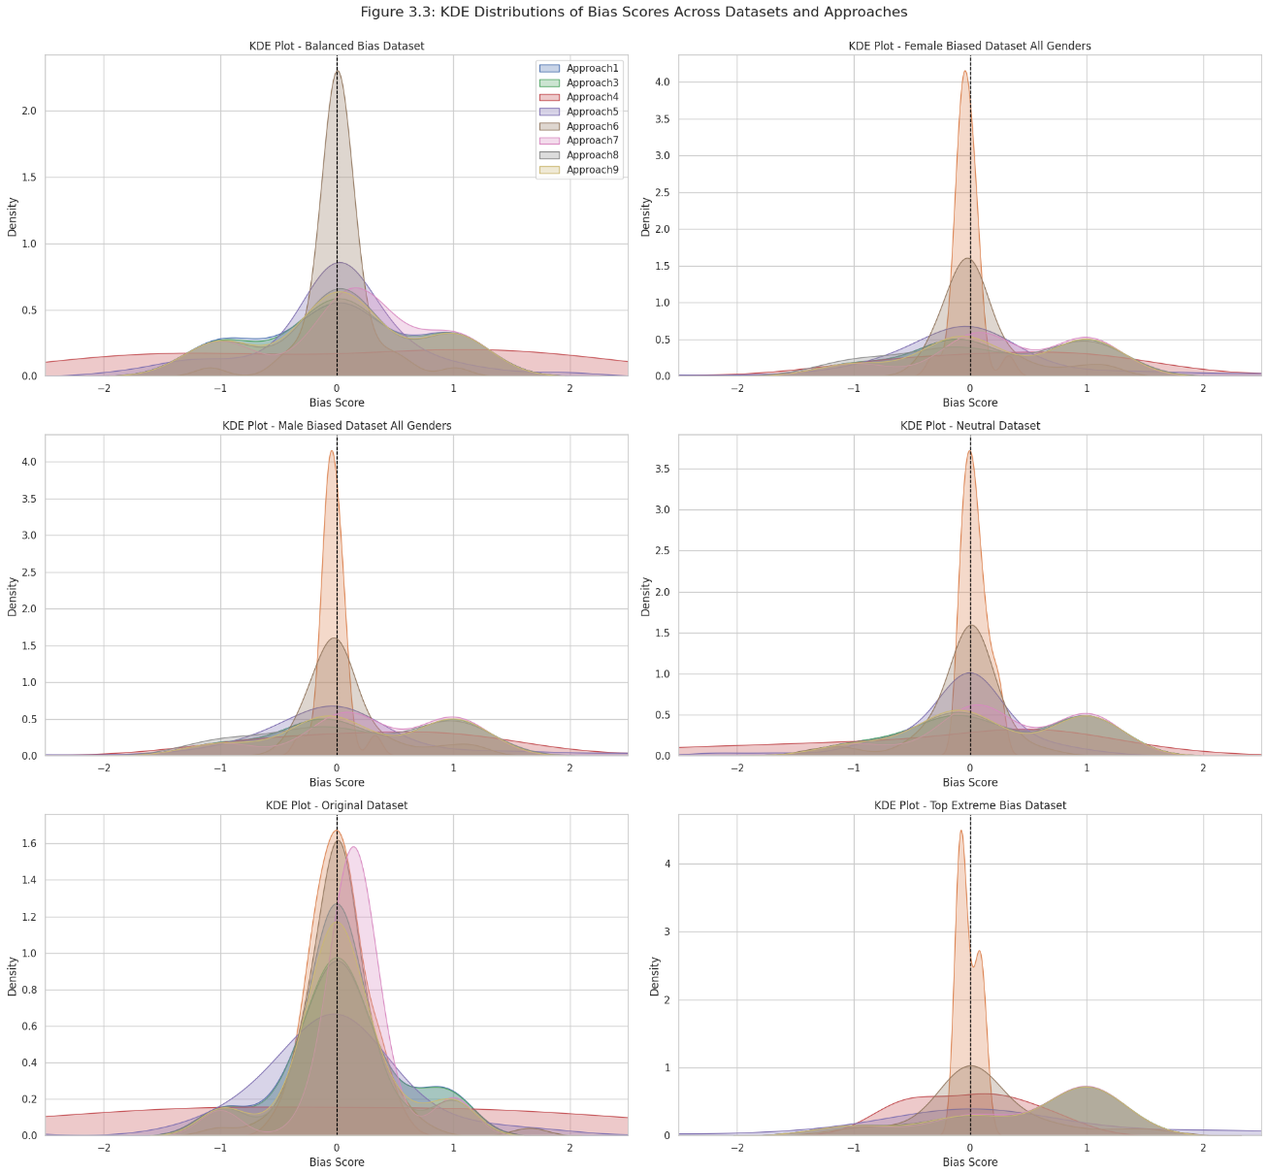
Approach Overview
Bias Score Distribution Across the Approaches – KDE charts - how scores cluster across datasets
Balanced Dataset shows fair and centered results across methods.
Male/Female-Biased Datasets show clear shifts, proving methods can detect bias.
Neutral Dataset has sharp peaks at zero, showing minimal bias.
Extreme Bias Dataset shows wide curves with heavy tails, as expected.
Original Dataset has varied results, reflecting real-world bias complexity.
IT21387562 | E.M.A.M.Ekanayake | 24_25J_195

Slide 36
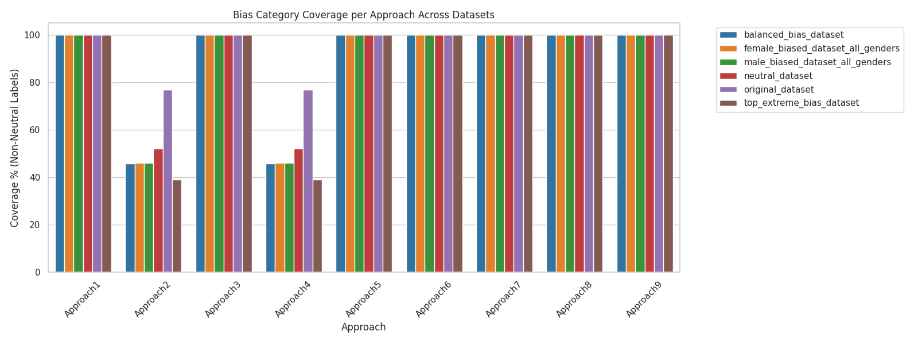
Validation - Object Category Coverage
Object Category Coverage
Measured coverage – % of object categories with a computed bias score
Approaches 1, 3, 5–9 achieved 100% object class coverage.
Approaches 2 & 4 failed to score all object classes.
High coverage = more reliable and fair bias detection across datasets
IT21387562 | E.M.A.M.Ekanayake | 24_25J_195

Slide 37
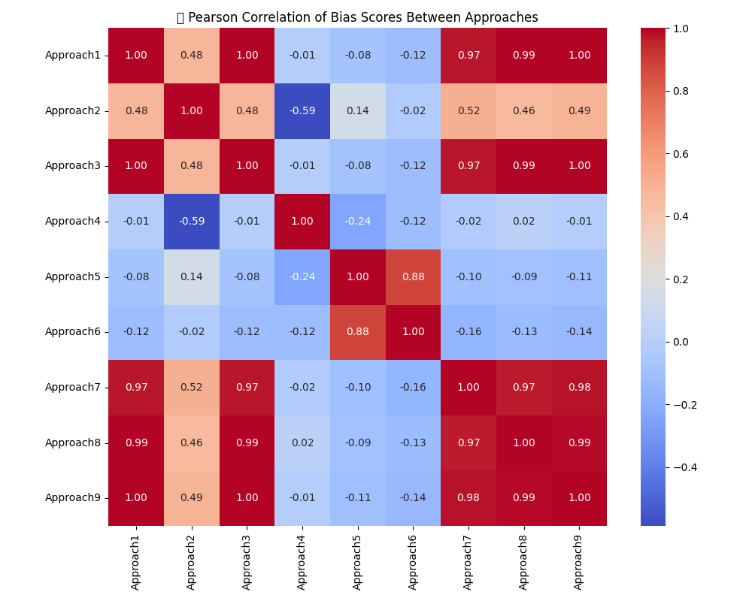
Validation - Correlation Analysis - Pearson
Measured Pearson correlation between bias scores from each approach to assess similarity.
Approaches 1, 3, 7, 8, and 9 → Highly consistent (correlation ≥ 0.97)
Approach 2 & 4 → Low or negative correlation, indicating instability or divergence
High correlation = robust & aligned methods
Low correlation = less agreement with other approaches
IT21387562 | E.M.A.M.Ekanayake | 24_25J_195

Slide 38
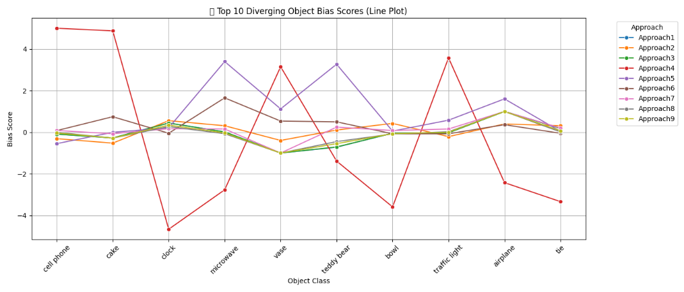
Validation - Divergence Analysis
Compared how differently each method scored the same objects.
Approach 4 shows extreme and inconsistent scores.
Other approaches (e.g., 1, 3, 9) stay near neutral, indicating stability.
Confirms Approach 4's over-sensitivity and reduced reliability for certain object classes
IT21387562 | E.M.A.M.Ekanayake | 24_25J_195

Slide 39
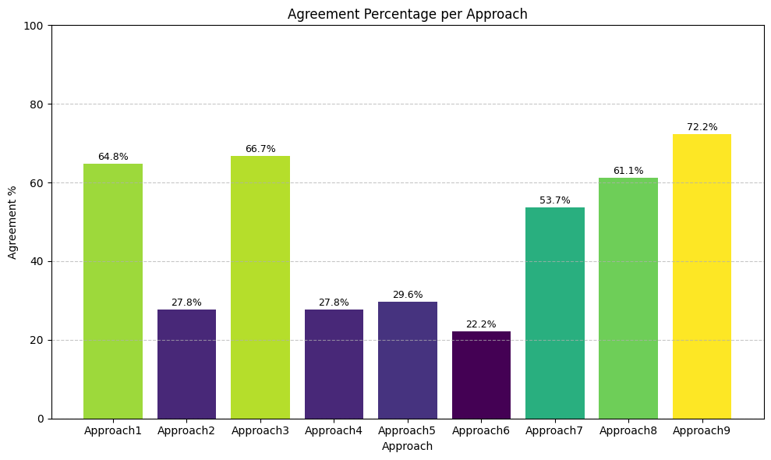



Real World Validation
Alignment with Real-World Model Misclassifications
Compared bias scores with gender misclassification trends from full-image predictions
Approaches 9, 8, and 3 showed the strongest alignment.
Confirms these scores reflect real-world prediction bias, not just theoretical measures.
male_pred_female_objects_merged_with_bias_updated.csv
IT21387562 | E.M.A.M.Ekanayake | 24_25J_195

Slide 40

Real World Validation
Ground Truth Benchmarking with Synthetic Bias Injection
Created a synthetic dataset with intentionally skewed gender labels.
Target objects:
Male-biased: skateboard, sports ball, bicycle
Female-biased: handbag, umbrella
Validate whether the UBM metric can detect artificial gender Bias.
IT21387562 | E.M.A.M.Ekanayake | 24_25J_195

Slide 41

Real World Validation
Dataset Preparation for Approach Behaviour Analysis to Analyze how contextual object bias shapes model predictions.
Extracted prominent person and contextual objects using metadata + UBM scores.
Built three datasets:
Neutral: Only neutral objects (UBM ≈ 0)
Male-Biased: Objects with UBM > 0.1
Female-Biased: Objects with UBM < –0.1
Ensured gender balance across all datasets.
IT21387562 | E.M.A.M.Ekanayake | 24_25J_195

Slide 42

Real World Validation
Trained 3 separate gender classification models to Observe how training on biased vs. neutral contexts affects model focus and behavior.
Trained 3 separate gender classification models:
neutral_model.pth (trained on neutral dataset)
male_model.pth (male-biased dataset)
female_model.pth (female-biased dataset)
IT21387562 | E.M.A.M.Ekanayake | 24_25J_195

Slide 43

Real World Validation
Validation Accuracy of the Models
Model | Accuracy | Male F1 | Female F1
Female-Biased | 69.0% | 0.53 | 0.77
Male-Biased | 80.0% | 0.83 | 0.75
Neutral | 61.3% | 0.62 | 0.60
Female-biased model favors female predictions, underperforms on males.
Male-biased model achieves highest overall accuracy, Favors male class.
Neutral model shows most balanced behavior but lowest performance — indicates less overfitting to gendered context.
IT21387562 | E.M.A.M.Ekanayake | 24_25J_195

Slide 44



Real World Validation
Grad-CAM Visualization of Model Attention
Applied Grad-CAM on random test images per model.
Visual heatmaps reveal where each model focuses during gender prediction.
Male-Biased Model → Focuses on objects like surfboards, tools, sports gear.
Female-Biased Model → Attends to kitchen tools, domestic settings, and clothing.
Neutral Model → Distributes attention more evenly across the person and scene.
IT21387562 | E.M.A.M.Ekanayake | 24_25J_195

Slide 45



Real World Validation
Human Perception Survey
Surveyed participants to label objects as male, female, or neutral
Clear patterns in perceived object-gender associations.
Approaches 9 & 3 showed the strongest alignment with human judgments.
Confirms real-world validity and human-aligned interpretability
IT21387562 | E.M.A.M.Ekanayake | 24_25J_195

Slide 46

Summary of Findings
Approach 9 (SHAP + PCA → Ridge) outperformed others across all metrics.
Strong alignment with real-world misclassification
100% object coverage across datasets
Balanced label distribution
High correlation with other trusted methods
Strong agreement with human perception
Balanced weights: 3D Distance, Depth, Size
IT21387562 | E.M.A.M.Ekanayake | 24_25J_195

Slide 47


Approach 9: PCA + SHAP + Ridge Regression
Why Combine SHAP + PCA + Ridge?
SHAP explains how features influence model predictions (not the predictions themselves).
PCA helps extract key spatial patterns.
Ridge learns the optimal weighting between OIS and SSB based on observed bias trends — it doesn’t generate labels.
IT21387562 | E.M.A.M.Ekanayake | 24_25J_195

Slide 48
Limitations and Future Works
Binary Gender Only
Labels limited to “male” and “female”.
Excludes non-binary or gender-fluid identities.
Future Work: Add support for non-binary and intersectional identities (e.g., gender × age)
2. Processing Time Overhead
Depth maps, and embeddings are computationally expensive.
Future Work: Optimize pipeline and explore real-time or batch scheduling solutions
IT21387562 | E.M.A.M.Ekanayake | 24_25J_195

Slide 49

IT21183690 | H.M.I.K. Dhanawardhana
Data Science
IT21183690 | H.M.I.K Dhanawardhana | 24_25J_195

Slide 50

Developing a metric for detecting Gender bias in Contextual Word Embeddings.
IT21183690 | H.M.I.K Dhanawardhana | 24_25J_195

Slide 51
Existing metrics and Related works.
Word Embedding Association Test(WEAT):
A. Caliskan, J. J. Bryson, and A. Narayanan, 2017,“Semantics derived automatically from language corpora contain human-like biases,”.
Scoring Association Means of Word Embeddings(SAME):
S. Schröder, A. Schulz, P. Kenneweg, R. Feldhans, F. Hinder, and B. Hammer,2024,"Evaluating Metrics for Bias in Word Embeddings," .
Pointwise Mutual Information(BiasPMI):
F. Valentini, G. Rosati, D. Fernandez Slezak, and E. Altszyler,2023, “The Undesirable Dependence on Frequency of Gender Bias Metrics Based on Word Embeddings,”.
IT21183690 | H.M.I.K Dhanawardhana | 24_25J_195

Slide 52

Limitations of existing metrics.
Most existing metrics for detecting bias in word embeddings focus on Cosine Similarity and word frequency. These approaches often conflate algorithmic bias with data bias and fail to fully capture the context in which words appear, especially in tasks requiring nuanced contextual understanding, such as coreference resolution.
IT21183690 | H.M.I.K Dhanawardhana | 24_25J_195

Slide 53



Factors Considered when Creating the Metric.
Cosine Similarity
Pointwise Mutual Information(PMI)
Contextual Embeddings(Euclidean distance)
IT21183690 | H.M.I.K Dhanawardhana | 24_25J_195

Slide 54
Building The Metrics.
Dataset Preprocessing
Extract the feature values
Gender Bias Metric with weighting
Testin and Evaluation
Calculation Gender Bias Score(CABM)
Finalize The weighting approach
Documenting The Findings
Deploy in ResAI toolkit
IT21183690 | H.M.I.K Dhanawardhana | 24_25J_195

Slide 55


Feature Extraction.
Pointwise Mutual Information(PMI)
IT21183690 | H.M.I.K Dhanawardhana | 24_25J_195

Slide 56


Feature Extraction.
Cosine Similarity Bias
Contextual_Bias(Euclidean distance)
IT21183690 | H.M.I.K Dhanawardhana | 24_25J_195

Slide 57


Dataset Overview
PMI_Bias and Cosine_Bias (-0.040) → Almost no correlation.
PMI_Bias and Context_Bias (0.015) → No meaningful correlation.
Cosine_Bias and Context_Bias (0.286) → Weak positive correlation.
VIF values are all near 1 (PMI_Bias: 1.002, Cosine_Bias: 1.006, Context_Bias: 1.005)
No redundancy (low VIF), meaning all three features are valuable for bias analysis.
IT21183690 | H.M.I.K Dhanawardhana | 24_25J_195

Slide 58


Collecting the data and Creating the dataset
Get the difference of Male female values for each occupation.
IT21183690 | H.M.I.K Dhanawardhana | 24_25J_195

Slide 59
How do we measure Gender Bias??
Since all three features are valuable for bias analysis.
Final Metric:
$$CABM = α∗\left(PMI_{male}−PMI_{female}\right)+β∗\left(Cosine_{male}−Cosine_{female}\right)+γ∗Context Bias$$
Positive CABM → Occupation is more male-associated in the dataset.
Negative CABM → Occupation is more female-associated in the dataset.
CABM close to zero → Occupation is gender-neutral.
IT21183690 | H.M.I.K Dhanawardhana | 24_25J_195

Slide 60

How do we measure Gender Bias??
IT21183690 | H.M.I.K Dhanawardhana | 24_25J_195

Slide 61


Approach 1: PCA-Based Bias Scores.
PCA → PCA Reduces dimensionality and keeps high-variance components.
IT21183690 | H.M.I.K Dhanawardhana | 24_25J_195

Slide 62

Approach 2: PCA/Random Forest Feature Importance
PCA → Reduces dimensionality while preserving variance, useful for datasets with low correlation.
Random Forest → Captures non-linear relationships(PMI_bias,Cosine Similarity), which is useful given the independent nature of the features.
IT21183690 | H.M.I.K Dhanawardhana | 24_25J_195

Slide 63

Approach 2: PCA/Random Forest Feature Importance
IT21183690 | H.M.I.K Dhanawardhana | 24_25J_195

Slide 64
Approach 3: SHAP + Random Forest Weights.
SHAP values provide interpretable feature importance, which is crucial for understanding bias.
Random Forest Captures non-linear relationships, which is useful given the independent nature of the features.
IT21183690 | H.M.I.K Dhanawardhana | 24_25J_195

Slide 65

Approach 3: SHAP + Random Forest Weights.
IT21183690 | H.M.I.K Dhanawardhana | 24_25J_195

Slide 66


Comparison of Approaches
IT21183690 | H.M.I.K Dhanawardhana | 24_25J_195

Slide 67
Validation of Approaches
Validating Using Statistical Testing
Mann-Whitney U Test: Tests for significant differences between male and female bias scores.
Shapiro-wilk Test: Tests for differences in the distributions of bias scores.
Method | Shapiro-Wilk Test (p-value) | Mann-Whitney U Test
SHAP + RF | 0.6390 ✅ | U = 198.0, p < 0.0001 ✅
PCA + RF | 0.0170 ❌ | U = 224.0, p < 0.0001 ✅
PCA Only | 0.3735 ✅ | U = 190.0, p < 0.0001 ✅
IT21183690 | H.M.I.K Dhanawardhana | 24_25J_195

Slide 68
Validation of Approaches
Validating Using Statistical Testing
Method | Std. Dev. | Variance | Cohen’s d | Median Diff.
SHAP + RF | 0.378 | 0.143 | 3.33 | 0.7008
PCA + RF | 0.505 | 0.255 | 4.14 | 1.0467
PCA Only | 0.385 | 0.148 | 3.69 | 0.7808
Stability: SHAP + RF has the lowest standard deviation and variance, meaning more consistent bias scores across occupations.
Discrimination: All methods showed Cohen’s d > 3.0, indicating strong separation between male- and female-biased groups.
PCA + RF had the strongest effect size (d = 4.14) but was also less stable. SHAP + RF provides the best balance between consistency and discrimination.
IT21183690 | H.M.I.K Dhanawardhana | 24_25J_195

Slide 69

Validation
Mention that PCA + RF may be under detecting directional bias.
Emphasize that SHAP + RF offers balanced, confident bias detection.
Highlight that PCA Only can over-amplify female bias, showing less consistency.
IT21183690 | H.M.I.K Dhanawardhana | 24_25J_195

Slide 70
Validation
Creating Datasets
Biased dataset consisted of 30 sentence templates(near 7000 sentences)
Balanaced dataset consisted (near 8000 sentences)
Pronoun | Sentences
He/She | [MASK]’s a OCCUPATION [MASK] is a OCCUPATION [MASK] will become a OCCUPATION [MASK] just started working as a OCCUPATION [MASK] is working as a OCCUPATION [MASK] was a OCCUPATION the OCCUPATION was in a hurry because [MASK] was late for work [MASK] is interested in becoming a OCCUPATION [MASK] does not like being a OCCUPATION [MASK]
Him/her | the OCCUPATION enjoyed [MASK] lunch the OCCUPATION missed [MASK] bus the OCCUPATION arrived in [MASK] car the OCCUPATION asked [MASK] boss for a promotion the OCCUPATION collected [MASK] check the OCCUPATION was chatting with [MASK] colleagues the OCCUPATION loves [MASK] job
IT21183690 | H.M.I.K Dhanawardhana | 24_25J_195

Slide 71
Validation
Validation Using BERT
After Finding Best Weights (SHAP+RF) for CABM metric, extracted features using THRE BERT MOdEL. 1.NORMAL BERT – pretrained model
2.BIASED BERT- Finde tuned using bias dataset (near 7000 sentences)
3.BALANCED BERT – Fine tuned using balance dataset (near 8000 sentences) Purpose: To evaluate how sensitive the CABM metric is to model-level changes, particularly shifts in cosine similarity and context bias features across different BERT variants.
IT21183690 | H.M.I.K Dhanawardhana | 24_25J_195

Slide 72


Validation
Unmasking Behavior with the Normal BERT
Unmasking Behavior with the Balanced BERT
IT21183690 | H.M.I.K Dhanawardhana | 24_25J_195

Slide 73


Validation
Fine-tuned BERT on biased occupation-pronoun dataset.
Unmasking Probabilities in Biased BERT
IT21183690 | H.M.I.K Dhanawardhana | 24_25J_195

Slide 74

Validation
SHAP + RF showed the highest agreement with unmasking predictions, proving its ability to align with real model behavior and confirming its role as the most interpretable and reliable weighting strategy in CABM.
Model | Occupations Compared | Matches (Same Bias Category) | Accuracy (%)
SHAP + RF | 39 | 27 | 69.23%
PCA + RF | 39 | 20 | 51.28%
PCA Only | 39 | 22 | 56.41%
IT21183690 | H.M.I.K Dhanawardhana | 24_25J_195

Slide 75
Summary Of Findings
Traditional metrics miss sentence-level bias
CABM combines Cosine, PMI, and Contextual Bias for better detection
All three features are valuable (low correlation, low VIF)
SHAP + RF is the best approach: interpretable, stable, and realistic
CABM aligns with real BERT behavior (69% unmasking match)
IT21183690 | H.M.I.K Dhanawardhana | 24_25J_195

Slide 76

Additional Testing WITH BERT
IT21183690 | H.M.I.K Dhanawardhana | 24_25J_195

Slide 77

Additional Testing WITH BERT
IT21183690 | H.M.I.K Dhanawardhana | 24_25J_195

Slide 78

IT21208294 | MUDALIGE T.N.
Data Science
IT21208294 | Mudalige T.N. | 24_25J_195

Slide 79

Developing Metrics for Detecting Gender Bias IN Video Datasets USED FOR ACTION RECOGNITION
IT21208294 | Mudalige T.N. | 24_25J_195

Slide 80
Motivation & Research Problem
Motivation:
Computer vision powers surveillance, sports analytics, and fitness applications.
But, these models may reflect gender bias embedded in training datasets.
Bias leads to unfair predictions and reinforcement of stereotypes.
Research Problem:
Video datasets introduce motion, temporal and spatial complexities.
There is no unified metric to evaluate gender bias in activity videos in dataset level.
IT21208294 | Mudalige T.N. | 24_25J_195

Slide 81
Research Objectives & Scope
Objectives:
Develop a multi-component metric for bias detection.
Components: Size, Centering, Screen Time, Motion, and Embedding Bias.
Use YOLOv8, MediaPipe, and SlowFast for feature extraction.
Normalize & aggregate into composite scores.
Scope:
Focused on binary gender bias (male/female) in video datasets.
Covers human activity recognition videos (HAR videos have one prominent person who is performing action).
(e.g., yoga, sports)
Applies to visual and motion-based cues only.
IT21208294 | Mudalige T.N. | 24_25J_195

Slide 82
Methodology Overview
Dataset Preparation (HAA500 subset)
Feature Extraction
YOLOv8 → Size & Center
MediaPipe → Motion
SlowFast → Embeddings
Bias Metric Computation
Aggregation
IT21208294 | Mudalige T.N. | 24_25J_195

Slide 83
Dataset Preparation – HAA500 Subset
Source Dataset:
HAA500 (Human-Centric Atomic Action)
591,000+ labeled frames
500 distinct atomic action categories
Fine-grained annotations tailored for action recognition tasks
Subset Selection Criteria:
Selected 500 videos from the full HAA500 dataset
Focused on clear gender labels (Male / Female)
Ensured diversity of actions (e.g., yoga, tennis, gym, diving)
IT21208294 | Mudalige T.N. | 24_25J_195

Slide 84


Feature Extraction
1. YOLOv8 – Person Detection (Per Frame)
We used the YOLOv8 model to detect only the main person in each video frame.
From that, we got:
x1, y1, x2, y2 → Coordinates of the bounding box
frame_width, frame_height → Coordinates of the frame
IT21208294 | Mudalige T.N. | 24_25J_195

Slide 85



Feature Extraction
2. MediaPipe – Pose Keypoints
We used MediaPipe to get the 33 body keypoints (x, y positions) per person.
That gives us 66 values per frame.
IT21208294 | Mudalige T.N. | 24_25J_195

Slide 86

Feature Extraction
3. SlowFast – Video Embeddings
We used the SlowFast ResNet-50 model from PyTorchVideo.
From each video, we sampled 32 frames, processed them, and passed them to the model.
It gave us one 2304-dimensional embedding vector for the whole video.
IT21208294 | Mudalige T.N. | 24_25J_195

Slide 87
Bias Components Selected for Gender Bias Detection
Size Bias – Visual Prominence
What it means:
Measures how large the detected person appears in the frame.
Why it matters:
Larger size = greater visual attention
Prior work linking bounding box size to unequal representation in image captioning and detection tasks.
IT21208294 | Mudalige T.N. | 24_25J_195

Slide 88
Bias Components Selected for Gender Bias Detection
2. Centering Bias – Framing Attention
What it means:
Measures how centered a person is in the frame.
Why it matters:
Centered subjects attract more viewer attention.
Prior Research showing center bias in surveillance and media datasets.
IT21208294 | Mudalige T.N. | 24_25J_195

Slide 89
Bias Components Selected for Gender Bias Detection
3. Screen Time Bias – Visibility Duration
What it means:
Measures how long a subject appears on screen during a video.
Why it matters:
Longer visibility = more influence in training and perception.
If one gender appears more frequently or longer, models may overfit on that group.
Literature connecting screen time to narrative dominance and data bias
IT21208294 | Mudalige T.N. | 24_25J_195

Slide 90
Bias Components Selected for Gender Bias Detection
4. Embedding Bias – Semantic Similarity
What it means:
Measures how semantically close a video is to male/female action patterns.
Why it matters:
Embedding space reflects deep model understanding.
Studies on pretrained vision-language models have shown that embeddings can encode gender associations
IT21208294 | Mudalige T.N. | 24_25J_195

Slide 91
Bias Components Selected for Gender Bias Detection
5. Motion Bias – Movement Patterns
What it means:
Measures differences in movement dynamics across genders.
Why it matters:
Gendered motion patterns (e.g., gait, posture) are often unintentionally learned and amplified by models during training.
Studies shows that body motion can clearly reveal gender, making it a useful sign of bias.
IT21208294 | Mudalige T.N. | 24_25J_195

Slide 92

Bias Metric Computation
Size Bias – Bounding Box Area
Inputs:
x₁, y₁, x₂, y₂​: Bounding box coordinates (from YOLO)
W, H: Frame width and height
Computation:
$$A_{bbox} =\left(x_{2}−x_{1}\right)∗(y_{2}−y_{1})$$
$A_{frame}=W∗H$
$$Rsize= \frac{A_{bbox}}{A_{frame}}$$
$$Size Bias=mean(Rsize​)∗\left\{\begin{aligned}+1 :if gender = male \\ −1 :if gender = female\end{aligned}\right.$$
IT21208294 | Mudalige T.N. | 24_25J_195

Slide 93

Bias Metric Computation
2. Centering Bias – Frame Position
Inputs:
Bounding box center (xc, yc)
Frame center (fx, fy) = (W/2, H/2)
Computation:
$$d = \sqrt{{(x_{c} + f_{x})}^{2}+{(y_{c} + f_{y}) }^{2}}$$
$D_{norm} = 1 − \frac{d}{(0.5∗\sqrt{W^{2}+H^{2}} )}$
$$Centering Bias=mean( D_{norm}​)∗\left\{\begin{aligned}+1 :if gender = male \\ −1 :if gender = female\end{aligned}\right.$$
IT21208294 | Mudalige T.N. | 24_25J_195

Slide 94

Bias Metric Computation
3. Screen Time Bias – Visibility Duration
Inputs:
fv: Number of person detected frames for a given video
T_{total}: Total number of person detected frames across all videos in the dataset
Computation:
$$Screen Time Bias = \frac{f_{v}}{T_{total} }∗ \left\{\begin{aligned}+1 :if gender = male \\ −1 :if gender = female\end{aligned}\right.$$
IT21208294 | Mudalige T.N. | 24_25J_195

Slide 95

Bias Metric Computation
4. Embedding Bias – Semantic Representation
Inputs:
V: Video embedding vector (SlowFast)
C_{male}, C_{female}: Gender-specific embedding centroids
Computation:
Normalize embedding : $V′ = \frac{V}{||V||}$
Cosine distances:
$d_{m} = cosine(V′, C_{male})$ , $d_{f} = cosine(V′, C_{female})$
Final metric:
$$Embedding Bias= d_{f} − d_{m}$$
IT21208294 | Mudalige T.N. | 24_25J_195

Slide 96

Bias Metric Computation
5. Motion Bias – Pose Dynamics
Inputs:
Pt : Pose keypoints at time t (from MediaPipe), normalized by frame size
Cmotion_male, Cmotion_female : Gender-specific motion centroids
Computation:
Frame-level motion vector:
$M=mean({|P}_{t+1} − P_{t}|)$ ; across all frames
Cosine distances:
$dm​=cosine(M,C_{motion_male})$ , $dm = cosine(M,C_{motion_female})$
Final score:
$Motion Bias= d_{f} − d_{m}$
IT21208294 | Mudalige T.N. | 24_25J_195

Slide 97

Bias Score Aggregation
PCA-Weighted Score
$$PCA Score= w_{1}B1+ w_{2}B2+ w_{3}B3+ w_{4}B4 + w_{5}B5$$
Uses Principal Component Analysis to give higher weights to components with more variance
Then scaled to a [−1, +1] range for interpretability
IT21208294 | Mudalige T.N. | 24_25J_195

Slide 98

Gender Bias Trends in Activity Classes
PCA-Weighted Bias Score
Key Insights:
Strong male: tennis_serve, badminton_underswing, backflip
Strong female: yoga_cat,
yoga_dancer, yoga_bridge
Example: gym_squat → mild in direction, but high PCA score
(hidden bias)
IT21208294 | Mudalige T.N. | 24_25J_195

Slide 99

Gender Predictive Validation of Bias Metric
VALIDATION
Goal was to Test if bias features can predict gender.
Model: Random Forest Features: Size, Centering, Screen Time, Embedding, Motion Bias Target: Gender (Male/Female)
Results:

Slide 100

Misclassification Alignment with Bias Scores
VALIDATION
Bias-Aligned Performance: Male-biased categories show higher F1 scores
for males, and female-biased ones favor female performance.
Model Disparity Evidence: Confirms that prediction bias affects model
accuracy across gender.
Supports Metric Validity: Our bias scores correctly identify which gender
performs better in each category.

Slide 101
Summary of Findings
To summarize:
Yoga actions consistently show female bias.
High-motion activities skew male.
Combining all features reveals hidden trends. This metric can now help identify and audit biased video datasets before model training.

Slide 102
THANK YOU !

